Slide 1
Pothole Detection App
Avinash Nair, Brady Cash, Zane Sanchez, and Jacob Guiang

Slide 2

Overview
Potholes cause 3 billion dollars in vehicle damage a year and affect millions of drivers
Repairing potholes are costly in money and time
The faster potholes are detected, the less damage they can do
We decided to build an application for pothole detection
Improve driver safety
Save costs

Slide 3
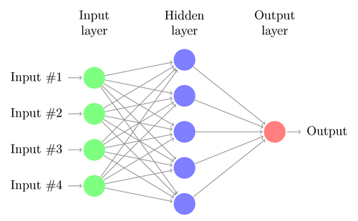
Initial Approach
We initially had a limited dataset
Considered building a binary classifier using a CNN
Simple, computationally cheap
Doesn’t provide much information

Slide 4

Method
Found a dataset with associated annotations
Decided to train a YOLO model
Chose YOLO v8 from ultralytics
More informative than binary classifier
Localization of multiple potholes
Can use live video stream- more useful for application

Slide 5
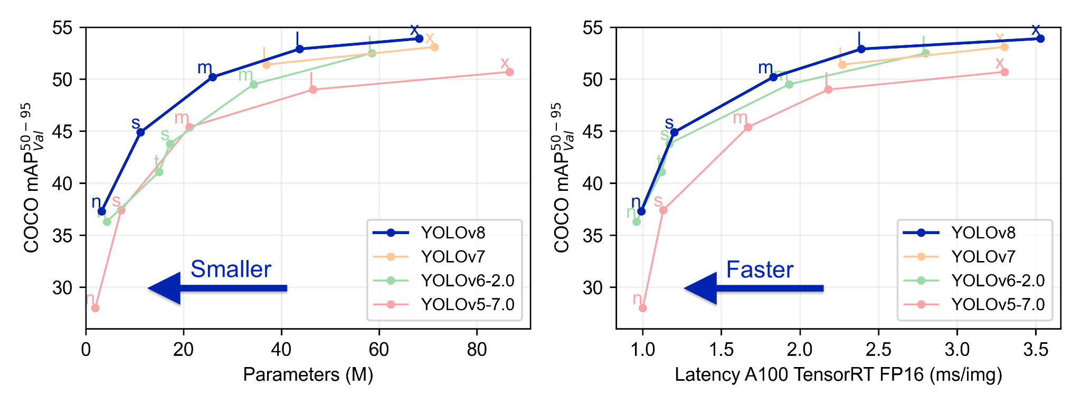
YOLO v8
Is the latest version of YOLO and builds upon previous versions while introducing new features and improvements
Offers object detection, segmentation, pose estimation, tracking, and classification

Slide 6
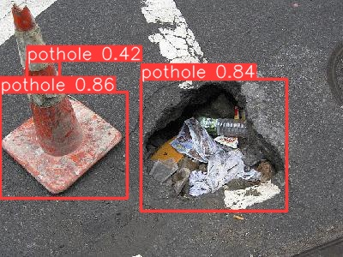
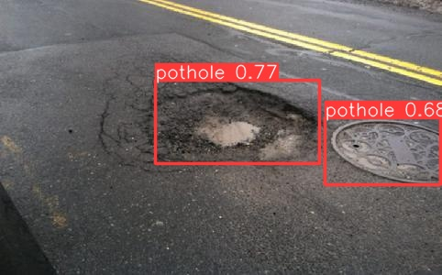
Issues
For some reason the model will identify manhole covers and traffic cones as potholes
Could be due to manhole color and other characteristics
We may be able to fix this if we were to increase our data set or if we simply trained our model to detect manhole covers and traffic cones as well

Slide 7
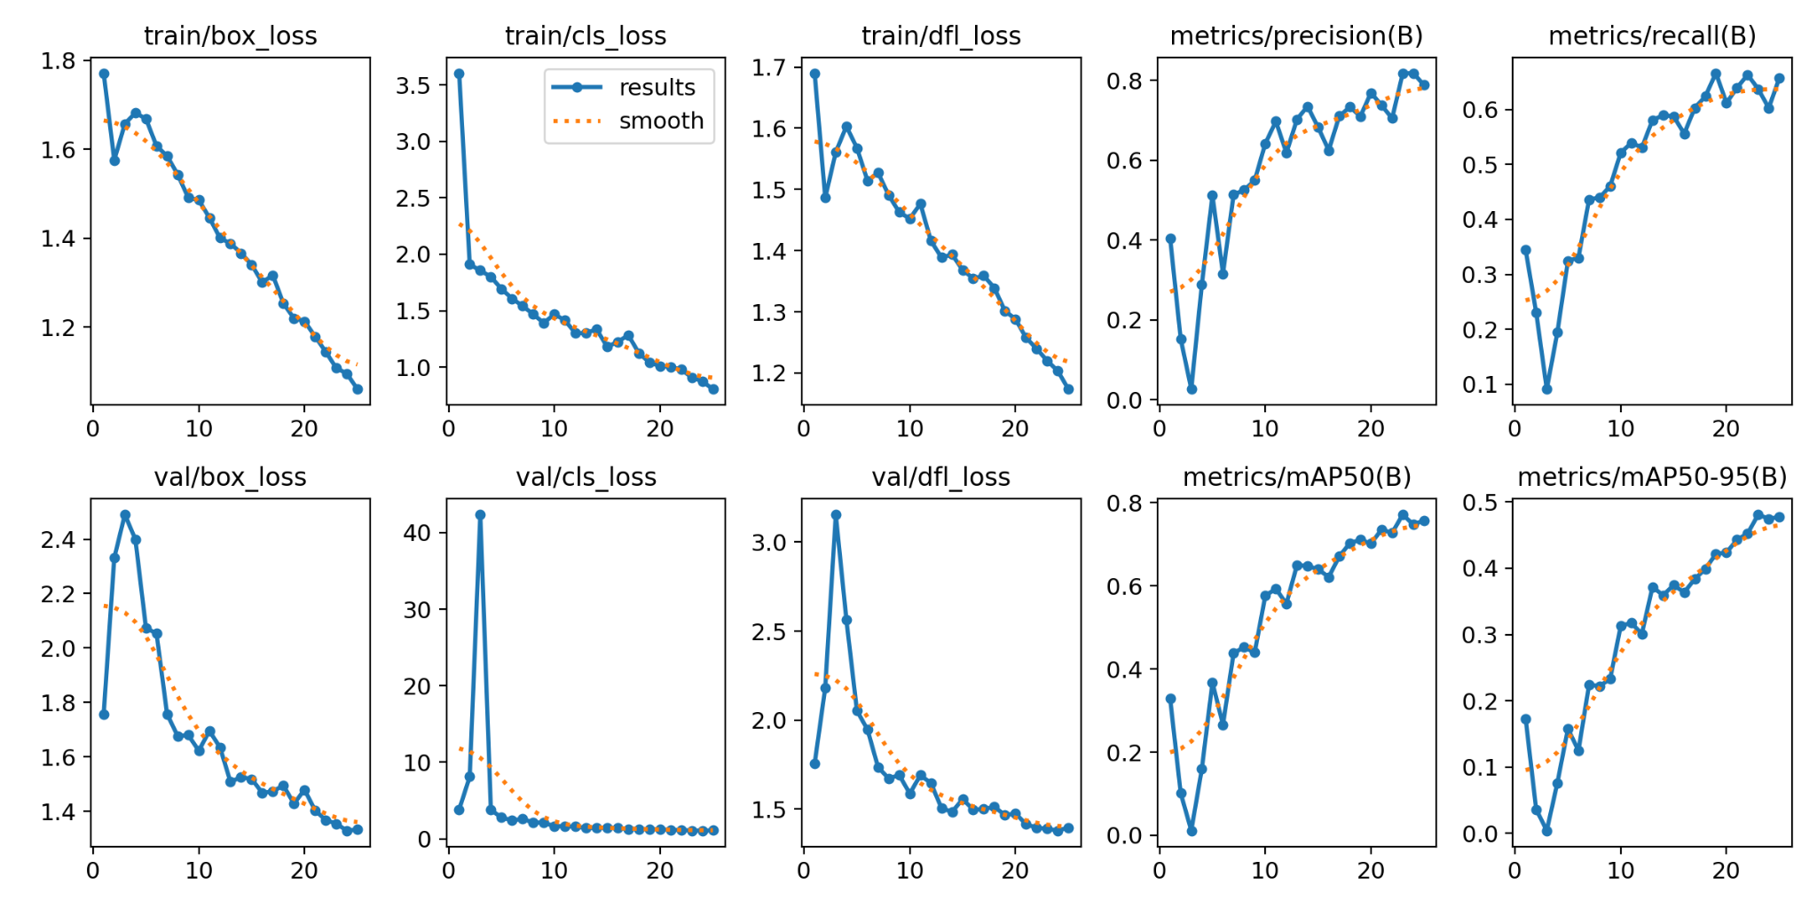
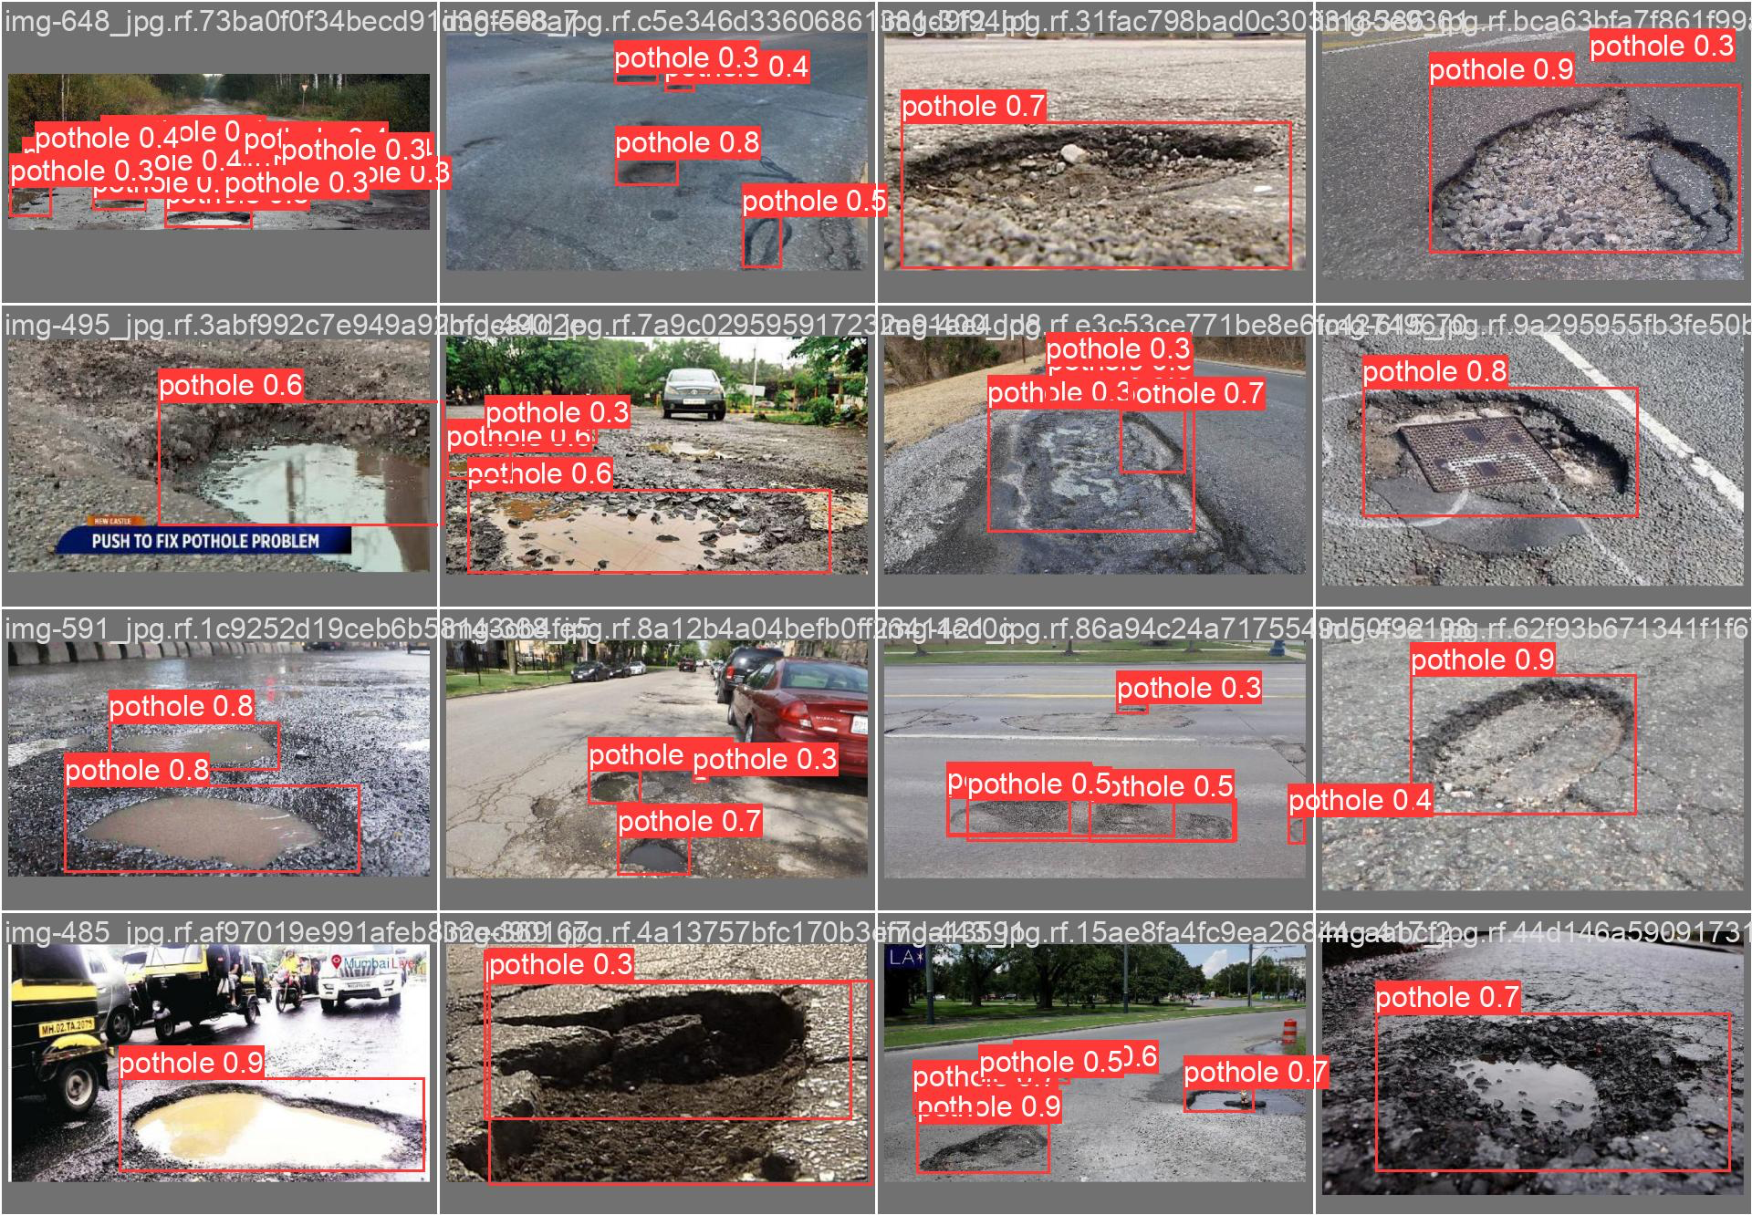
Results

Slide 8
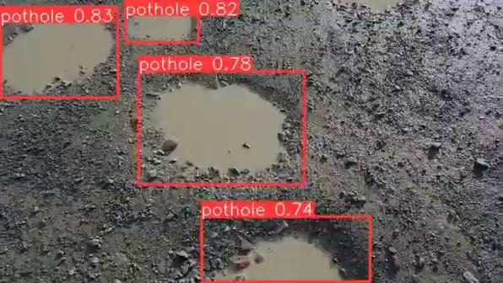
Model Video Demo

Slide 9
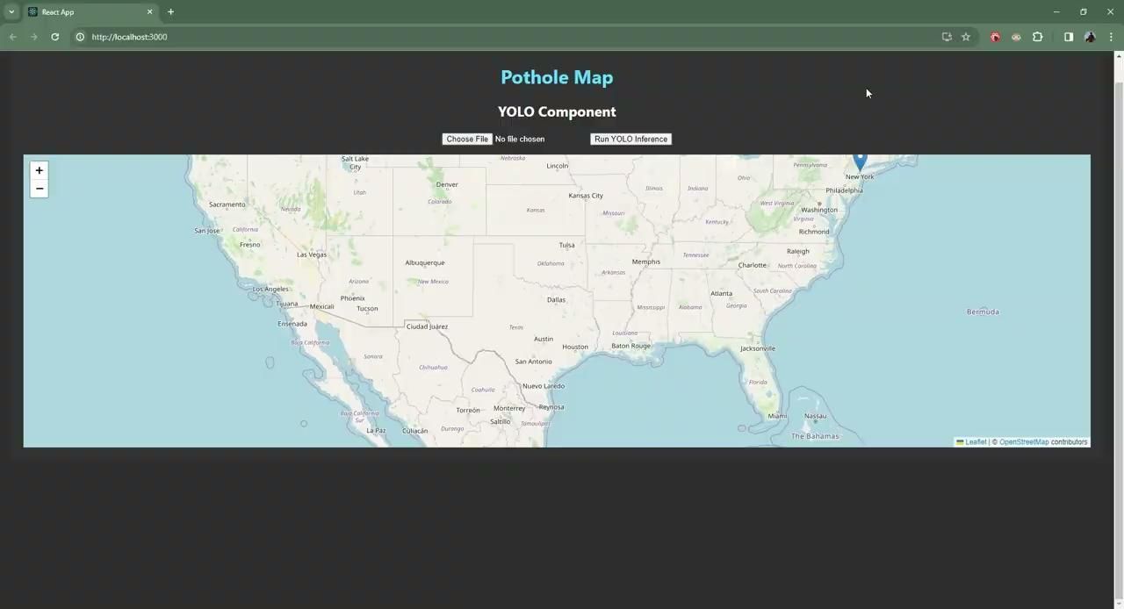
Frontend Demo

Slide 10
Thanks for listening!
Any questions?

Slide 11
Sources
Undraw.com
https://github.com/ultralytics/ultralytics
https://publicaffairsresources.aaa.biz/wp-content/uploads/2016/02/Pothole-Fact-Sheet.pdf

